Slide 1
NASA Space Weather Program
Open R2O2R Pipeline
Lisa Winter, R2O2R Lead
NASA Space Weather Program
CCMC 2024 Workshop
5 June 2024

Slide 2
Space Weather Program R2O2R Program Element
Annual R2O2R Solicitation
New approach continues to meet NASA’s responsibilities as defined in PROSWIFT Act, National Space Weather Strategy & Action Plan, etc.
New approach addresses issues & actions identified by NASA, NOAA, NSF, DoD, and the science community.
New approach is truly interagency. Combination of NASA, NSF, and NOAA resources and methods to create new R2O2R communities.
NASA Lead: Dr. Lisa Winter, on detail from NSF
NASA Deputy Lead: Dr. Esayas Shume
Ideas Lab
Open Call
Focused R2O2R Topics
HQ collaborates with NOAA, NSF, etc. to select topic for year
Researchers, end-users, and operational partners develop project ideas together
Selected proposals come from Lab
Open R2O2R Topics
Innovative and application-ready ideas from science community
No deadline; variable length
More fully utilize two-step review process to ensure applicable selections are being made
Enhanced Management
Monthly PI meeting
Quarterly Program Review
Annual R2O2R Meeting
Transition

Slide 3
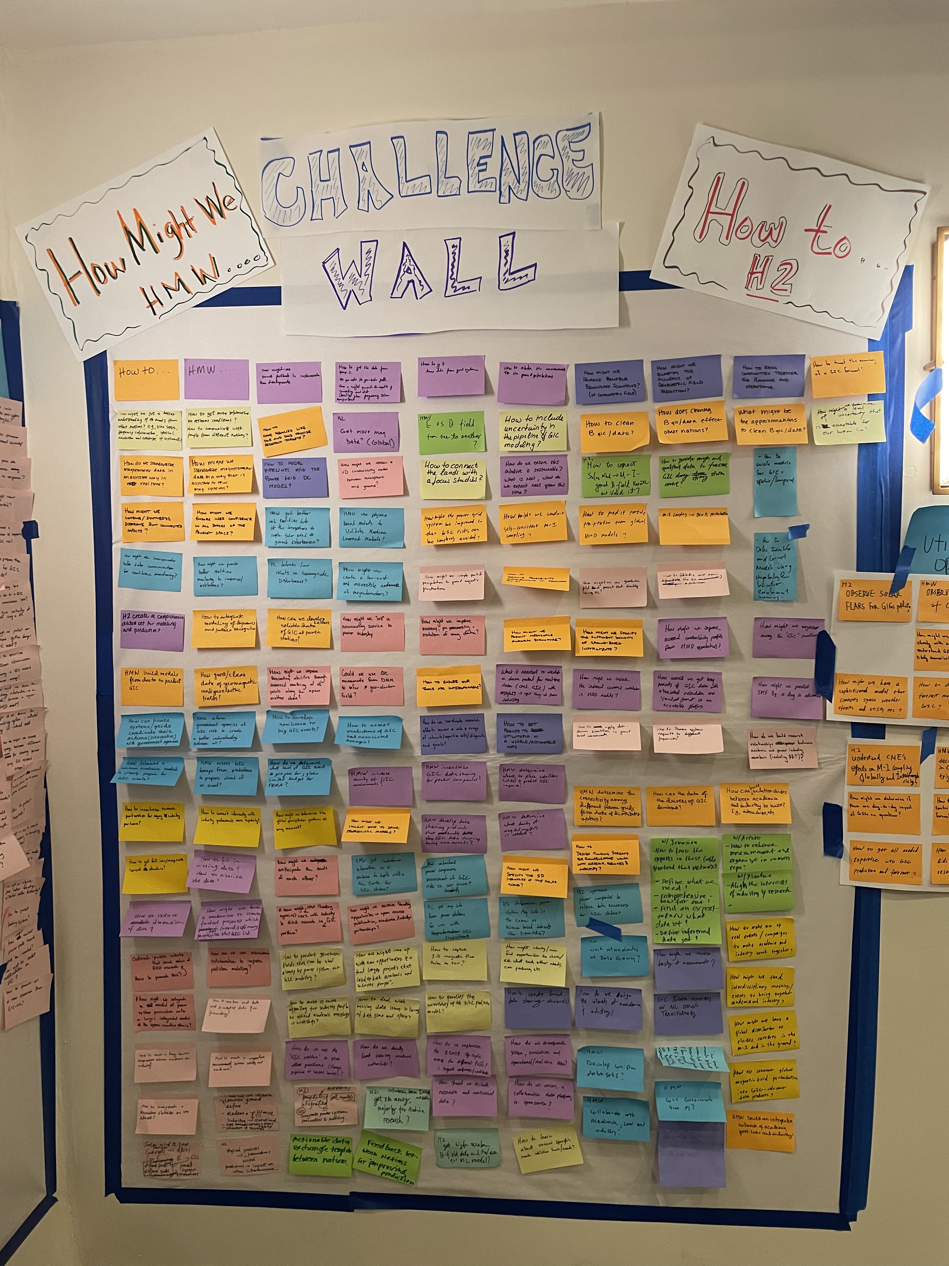
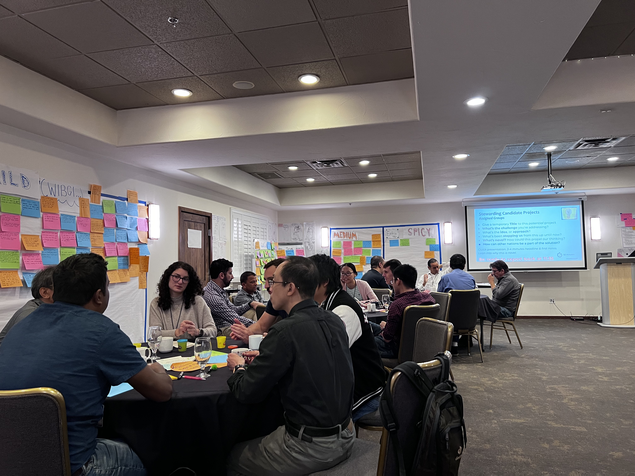
Previous Space Weather Ideas Lab
Pilot NASA/NSF/NOAA SWPC Ideas Lab held in November 2022 on “Geomagnetically Induced Currents and their Effects on the Power Grids” (led by L. Winter, J. Woodroffe, M. Cash)
What were the outcomes? Building community of users, researchers, and operations.
New Labs will continue to build community and R2O2R projects that involve the whole chain from operations to research

Slide 4
Previous Activity SWx Ideas Lab
Pilot NASA/NSF/NOAA SWPC Ideas Lab Nov 2022
Geomagnetically Induced Currents and their Effects on the Power Grids
Outcomes:
White Paper from mentors on recommendations for GIC research/community
Follow-up GIC workshop scheduled for Oct 2024 at UMD-CP
New USGS-partnership on magnetometer development
USGS/NASA GSFC effort to revitalize the 5-meter Braunbeck coil at the Fredericksburg Geomagnetic Observatory for student projects and operations
USGS/academic partnership to build magnetometers on college campuses (UNH, Michigan)
Lessons Learned:
Funding attached to the Lab gives increased focus to the participants (through ROSES call) and government partners
Engagement with industry would benefit from salary for these participants during the Lab (i.e., interest but difficult to justify time away from the office for a week)

Slide 5
Open R2O2R Call
No deadline to allow proposals to come in on timely topics
Open call to encompass innovative and early readiness level ideas
Fund 1-, 2-, or 3-year projects on R2O2R
Require a Step-1 to ensure that the topic area is R2O2R and guide PIs to the appropriate HPD ROSES solicitation
Increasing the length of projects addresses OMB/OSTP recommendation: Successful transition from research to operations takes time and the current two-year R2O2R opportunities do not provide enough time to prepare for ingestion into operations.

